Slide 1
Lecture 4c : MIPS Instruction Set
To watch lecture video click link below
Lecture 4c video
Correction: in video Lecture 3c should be Lecture 4c
To view slides, continue to next slide

Slide 2
Lecture 4c : MIPS Instruction Set

Slide 3
Binary Representation of MIPS Instructions
Why binary representation?
Memory location can only store 0s and 1s;
Instructions are stored in the memory;
Therefore, binary representation of instructions.
How to represent MIPS instructions in binary?
Three types of instructions
R type (for instructions of operands in registers)
I type (for instructions with immediate data)
J type (for jump instruction with memory address)
How to: that’s an important ISA design issue.

Slide 4
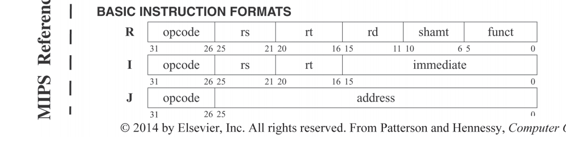
MIPS Instruction Set: Reference Data
This is the most important resource for MIPS instruction set.
Attached in Module 3
It’s commonly called Green Sheet
in hardcopy of the book, printed on green paper.
Table 1: Basic Instruction Format (on lower left corner.)

Slide 5
R-type instructions
Format (fits one 32-bit word)
opcode rs rt rd shamt funct
6 bits 5 5 5 5 6
opcode: operations of the instruction (6 bits)
rs: register source 1 (5 bits)
rt: register source 2 (5 bits)
rd: register destination (5 bits) Note: rd (destination) at the last.
shamt: shift amount (5 bits)
funct: function code (6 bits)
Instructions
add, sub, and, or, …,

Slide 6
R-type Format: Explanation
Opcode (6 bits)
ISA designers decided to use 6 bits for opcode;
Detailed explanation omitted here.
That means we’re able to represent 2⁶ different operations
e.g. opcode could be 000000, up to 111111
Register numbers are 5 bits (why? – thinking questions)
Hint: review machine organization, how many (int) registers MIPS has?
Shamt (shift amount) 5 bits
Not used in our case, so let these be 00000
Funct (function code) 6 bits
These are 6 extra bits available in R-type;
What can we use these bits?
Which of the above fields would like to have more bits?

Slide 7
Funct Code
This is the special design of MIPS
MIPS would like to use these extra bits to support more operations (i.e. as an extension to opcode).
The Design:
When opcode is 000000, it represents a group of arithmetic and logic operations
R-type instructions thus refer to Arithmetic/Logic instructions
Specific operations are designated by funct code, e.g.
add: opcode is 000000, funct code is 20₁₆ (i.e. 32₁₀)
or: opcode is 000000, funct code is 25₁₆ (i.e. 37₁₀)
(see highlighted text in next slide)

Slide 8
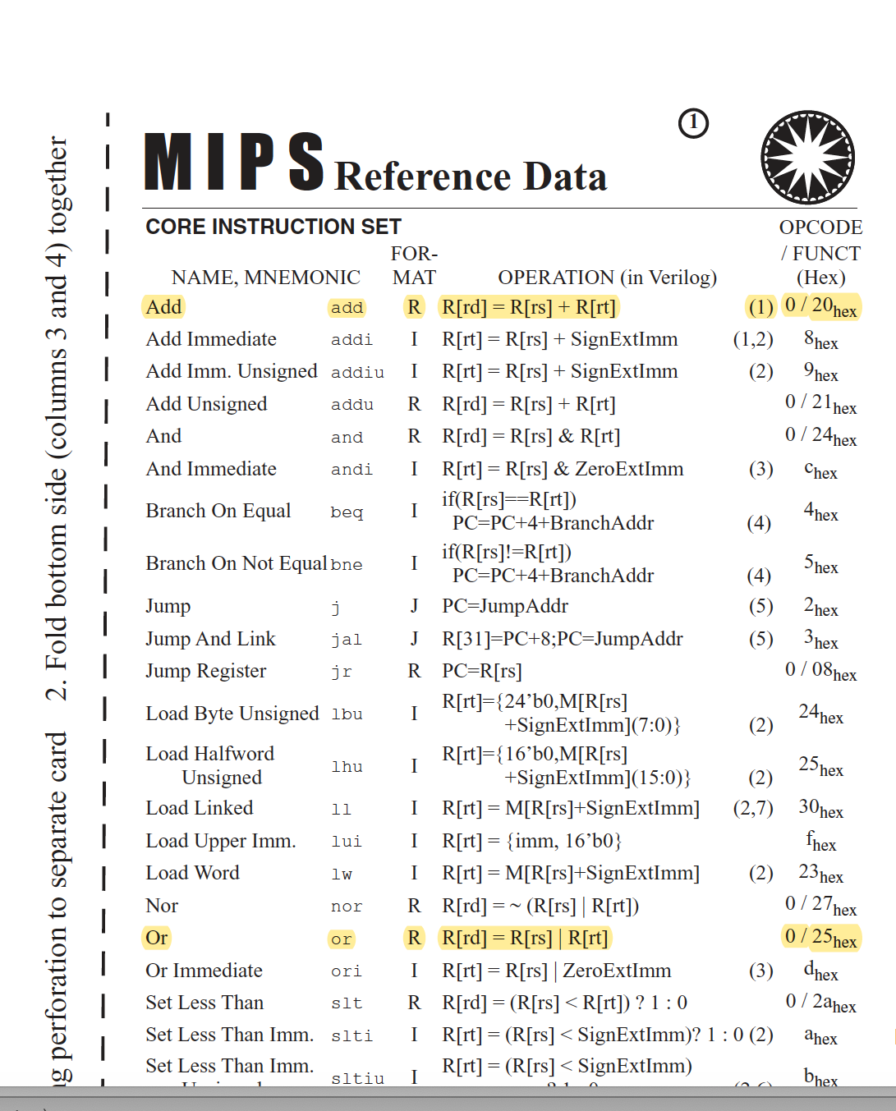

Slide 9
Converting R-type Instructions to Binary
Example Add R8, R17, R19
Step 1: Check MIPS Reference Data (Green Sheet)
Under row Add, column Format: we found R
Step 2: Bring up R-format
Step 3: Fill in add R8, R17, R19 info to R-format fields
Opcode (6 bits) | Rs (5 bits) | Rt (5 bits) | Rd (5 bits) | Shamt (6 bits) | Funct (6 bits)
add | 17 | 19 | 8 | 0 | funct
Notes: (1) register order: destination register #, R8 move to last, i.e. Rd;
(2) Shamt: it’s always 0

Slide 10
Converting R-type to Binary(cont)
Step 4: Find opcode and funct from MIPS Reference Data (The last column: 0/20_{hex}
Step 5: Put opcode and funct to the fields
Step 6: Convert to binary according to the bits in each field
Step 7: Final result 000000 10001 10011 01000 00000 100000
Could be written as:
0000 0010 0011 0011 0100 0000 0010 0000
0 | 17 | 19 | 8 | 0 | 20_{hex}
000000 | 10001 | 10011 | 01000 | 00000 | 100000
Note: to fit 20_{hex} into 6 bits, use 2 bits for 2 (10) and 4 bits for 0 (0000), thus, 20_{hex} -> 00 1000

Slide 11
Practice
Note: In zyBook, register conventions such as $s0, $t0 are used. Convert these registers to direct register numbers first.
Let’s try for And R9, R15, R17
Hints:
Please note the difference between opcode and funct.
It’s AND instruction, not ADD instruction.

Slide 12
Practice
The bit pattern below represents a MIPS instruction, what does it represent?
0000 0001 1111 0001 0100 1000 0010 0100
(hint: similar strategy as previously but in reverse direction.)

Slide 13
I-type Instruction Format
Format
Opcode rs rt address
(6 bits) (5) (5) (16)
Instructions
beq (opcode: 4), bne (opcode: 5), …
For simplicity, we provide these two instructions in the following format where the 16-bit offset is given in hex format.
beq R16, R17, 0x0008
lw (opcode: 23_{hex} or 35₁₀), sw (opcode: 2b_{hex} or 43₁₀), …
lw R15, 0x0008 (R16)
sw R15, 0x0004(R16)
addi, andi, ori, …

Slide 14
Converting beq/bne to Binary
Instruction: beq R16, R17, 0x0008
Step 1: MIPS reference -> Format for beq is I.
Step 2: Bring up I format
Step 3: Fill up I format with instruction details
Note: MIPS swaps Rs, Rt => explanation omitted. In our exercise, either 16, 17 order or 17, 16 order okay.
Step 4: Convert to binary
Final result:
0001 0010 0011 0000 0000 0000 0000 1000
Opcode (6) | Rs (5) | Rt (5) | Imm (16)
Beq opcode: 4 | 17 | 16 | 0x0008
000100 | 10001 | 10000 | 0000 0000 0000 1000

Slide 15
lw and sw Instructions
lw: load a word from memory
e.g. lw R8, 0x0020(R18)
Per discussion in Lecture 3a, the memory address of data is calculated as:
addr <- Reg[R18] + SignExt(0x0020)
Then, we load the data from memory to R8, i.e.
Reg[R8] <- Mem[addr] #read from memory
sw: store a word to memory
e.g. sw R8, 0x0020(R18)
Memory address calculation: same as lw
To store data: Mem[addr] <- Reg[R8] #write to memory

Slide 16
Converting lw/sw to Binary
Instruction: lw R8, 0x0020(R16)
Step 1: MIPS reference -> Format for lw/sw is I.
Step 2: Bring up I format
Step 3: Fill up I format with instruction details
Note: in this example R16 is Rs, R8 is the Rd for lw and Rt for sw.
Step 4: Convert to binary
Final result for lw:
1000 1110 0000 1000 0000 0000 0010 0000
(for sw, the opcode is 0x2b, i.e. 101011, all other parts are the same. )
Opcode (6) | Rs (5) | Rt /Rd (5) | Imm (16)
lw opcode: 0x23 | 16 | 8 | 0x0020
100011 | 10000 | 01000 | 0000 0000 0010 0000

Slide 17
J-type Instruction Format
Format:
Opcode address
(6 bits) (26 bits)
Instruction: J addr
Conversion of J instruction to binary omitted.

Slide 18
Practice
Same MIPS instructions
Lw R24, 0x0014(R12)
Addi R24, R12, -4
#Note: First, convert -4 to 16-bit 2’s complement, then follow the conversion procedure we stated, with reference to the “Green Sheet” you should be able to convert this one.
Beq R24, R12, 4

Slide 19
Practice
Given the instruction bit patterns, what instruction (specially) does each represent?
100011 01100 11000 0000000000010100
001000 01100 11000 1111111111111100
000100 01100 11000 0000000000000100

Slide 20
Summary
MIPS instructions
R-type
Opcode: 000000
For a group of arithmetic and logic operations
I-type
With an immediate in instructions
Focused on beq, bne, lw, sw instructions
Additional instructions such as addi, andi, ori can be learned in similar way
J-type
Details omitted

